Slide 1
Sensitivity of Large-Scale Circulation and Wave Propagation to Tropical Shallow/Deep Diabatic Heating

Slide 2
Outline
Introduction
Background, Motivations, Hypothesis
Model and experimental design
Results
Summary
References

Slide 3
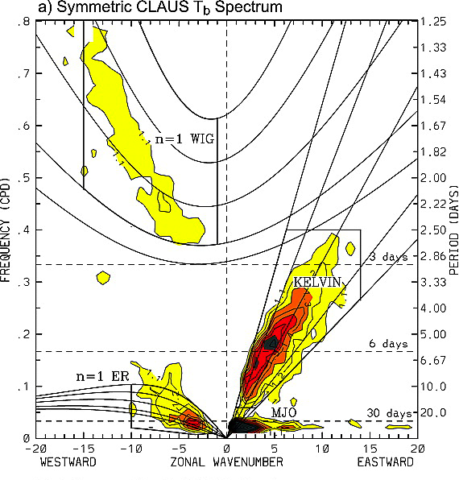
Kiladis et al., 2009

Slide 4
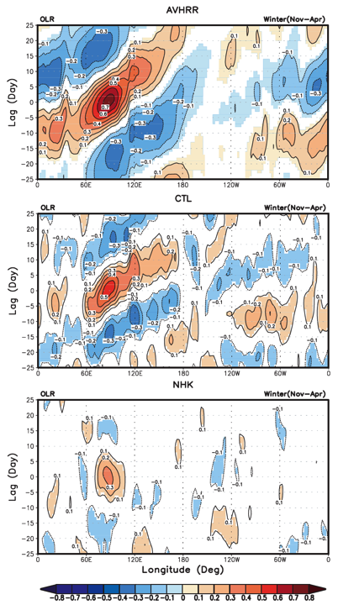
OBS
Revised ZM + Hack
No Hack shallow scheme
Shallow convection serves to precondition the lower troposphere by moistening it ahead of deep convection;
A correct simulation of the interaction between deep and shallow
convection is key to MJO simulation.
Shallow: trigger
Deep: maintain
Zhang and Song, 2009

Slide 5
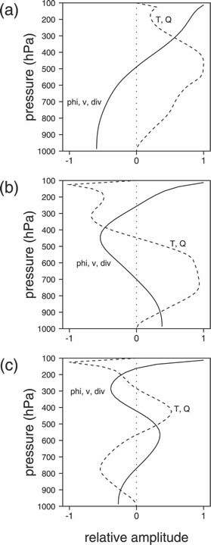
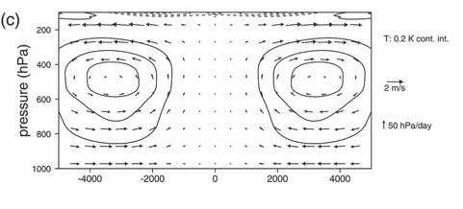
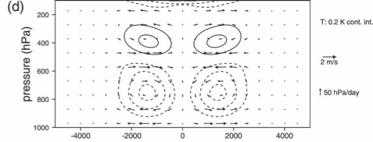
Mode 1
Mode 2
Mode 3
Mode 1
Mode2+3
The horizontal divergence contributed by shallow modes is an important factor in the column-integrated moist enthalpy budget. These modes converge moist static energy for a time prior to when deep circulations export moist static energy.
Haertel et al., 2008

Slide 6
Hartmann et al., 1984: a heating profile with a strong maximum at 400hPa and weak maximum below 400hPa can produce a reasonable east-west (i.e. Walker) circulation;
Lau and Peng, 1987: (mobile) wave-CISK (24 days)
Sui and Lau, 1989: different heating profiles
Fast mode: peak at 500 hPa; 26 days
Slow mode: peak in 500~700 hPa; 52 days
Wu, 2003: analytical solution of large-scale circulation forced by deep and shallow heating, with a set of linear equations; “shallow CISK, deep equilibrium”

Slide 7
Introduction
Why study this topic
E.g. Walker circulation; MJO eastern propagation which is not well understood
Why separate it into deep and shallow modes?
OBS: distinguished; 20% shallow; different impacts on large-scale circulation; very important in simulating MJO
Why use this model (dynamic core)?
Idealized, simple: isolate the impact from other interactions;
Helps to directly see the interaction between heating and circulation; easy to explore the mechanism

Slide 8
Motivations
How do tropical circulation and wave propagation response to different diabatic heating profiles (i.e. deep and shallow modes)?
What are the differences?
Why are they different?

Slide 9
Hypothesis
Large-scale circulation
Shallow diabatic heating induces stronger low-level convergence, which feeds the stronger convection.
Wave propagation
Shallow diabatic heating generates slower (reasonable) eastward wave propagation.

Slide 10
Brief description of the model
An AGCM dynamical core with Python
primitive prognostic equations: u, v, T, q, ln(ps);
spherical harmonic spectral dynamical core;
flexible vertical hybrid coordinate and horizontal resolution;
semi-implicit time-integration;
acceptable running speed on PC;
concise coding style;
easy to read and tune all parameters;
convenient for I/O, visualizing, analyzing, etc.;
flexible on every platform: Windows, MAC, Linux

Slide 11
Experimental design
Resolution: T30L18
Rayleigh friction: 5 day⁻¹
Newtonian cooling: 5 day⁻¹
a) Steady forcing
ID | Physics | Mode | Time
s_dp | steady | deep | 300 d
s_sh | steady | shallow | 300 d
b) Local oscillating forcing
ID | Physics | Mode | Time
o_dp | oscillate(44 day) | deep | 100 d
o_sh | oscillate(44 day) | shallow | 100 d

Slide 12
Initial condition: oscillating cases @ 44th day
c) Suddenly shut down heating: decayed wave cases
ID | Physics | Initial Condition | Time
d_dp | None | s_dp: 300th day | 100 d
d_sh | None | s_sh: 300th day | 100 d
d) Wave-CISK like physics: PBL convergence triggered heating
ID | Physics | Mode | Time
p_dp | PBL convergence | deep | 100 d
p_sh | PBL convergence | shallow | 100 d

Slide 13
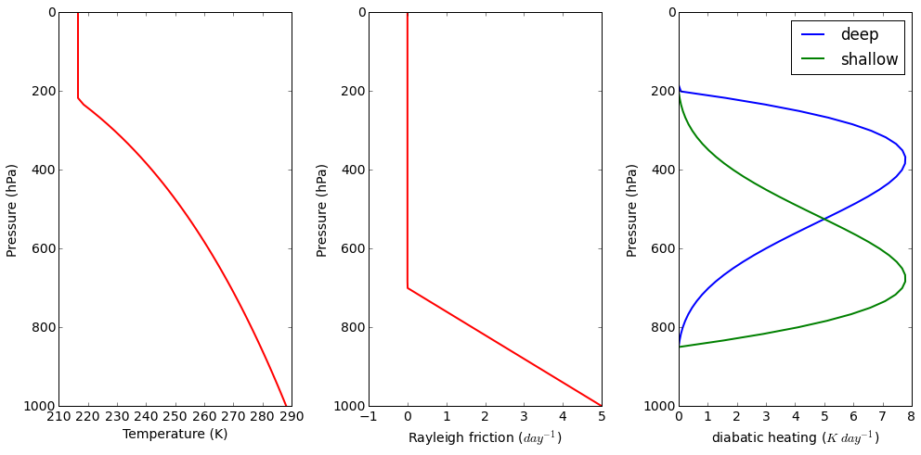
Initial condition (Te): resting atmosphere with constant lapse rate in troposphere and constant temperature in stratosphere
Rayleigh friction: linear friction from 700hPa to surface
Diabatic heating: the shape is controlled by skewness (0~1)
(0.2: deep; 0.8: shallow)
217K
6.5 K/km
288K
PREC ~ 10 mm/day

Slide 14
Results
large-scale circulation responses
horizontally and vertically
Wave propagation
Spectral analysis
Sensitivity to model parameters
Resolution; Rayleigh friction; Newtonian cooling; cloud (heating) top and base; heating strength; initial condition etc.

Slide 15
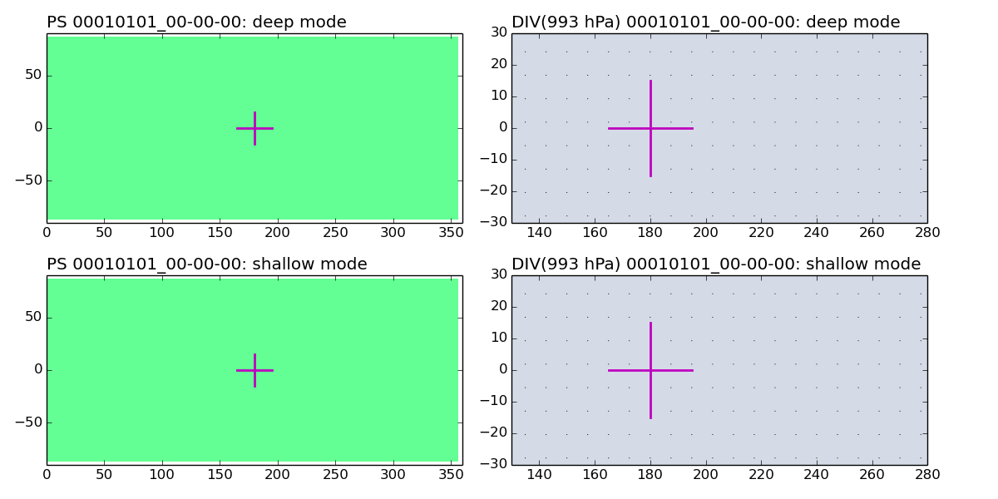
Steady forcing: Day 0

Slide 16
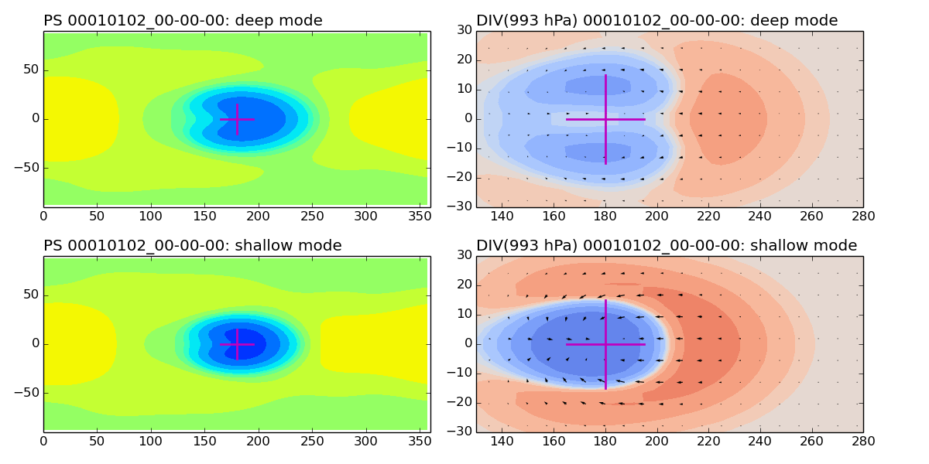
Steady forcing: Day 1

Slide 17
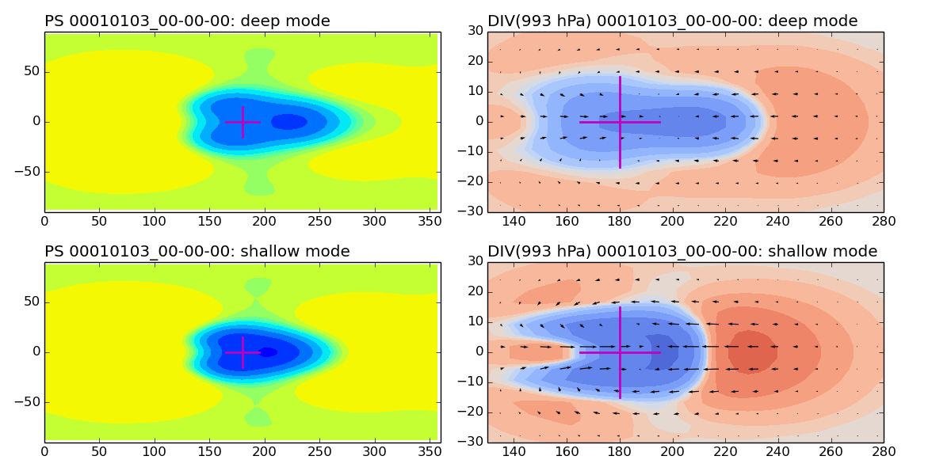
Steady forcing: Day 2

Slide 18
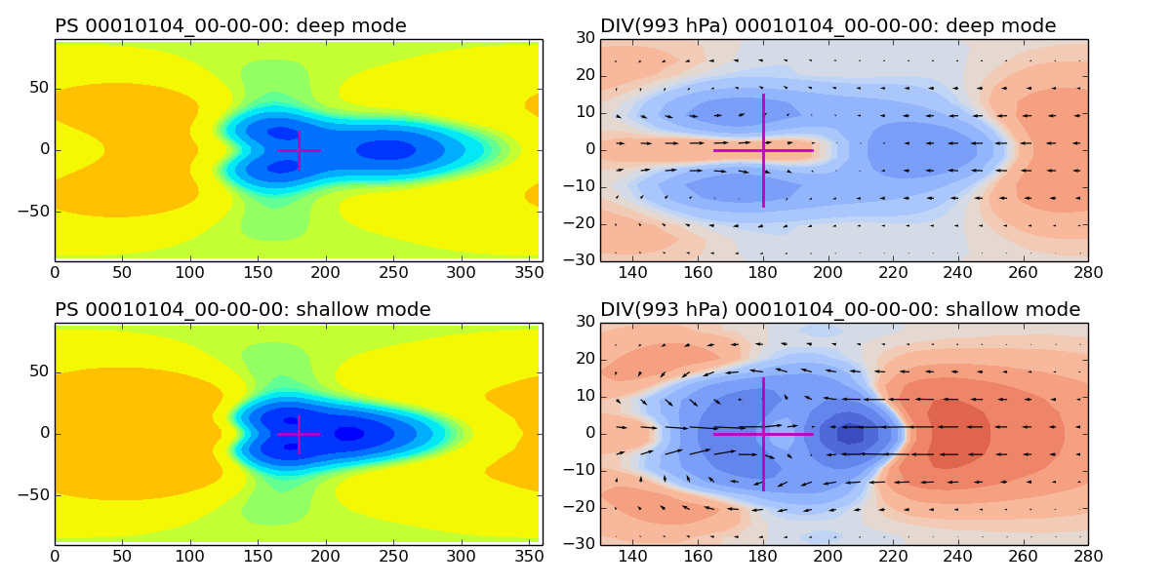
Steady forcing: Day 3

Slide 19
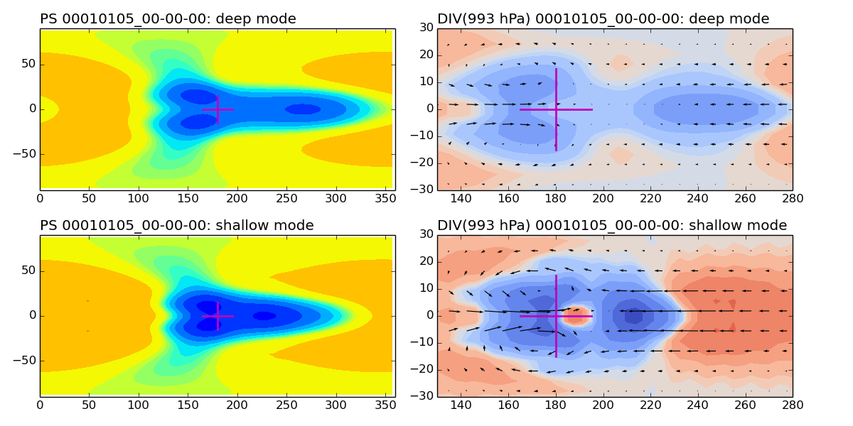
Steady forcing: Day 4

Slide 20
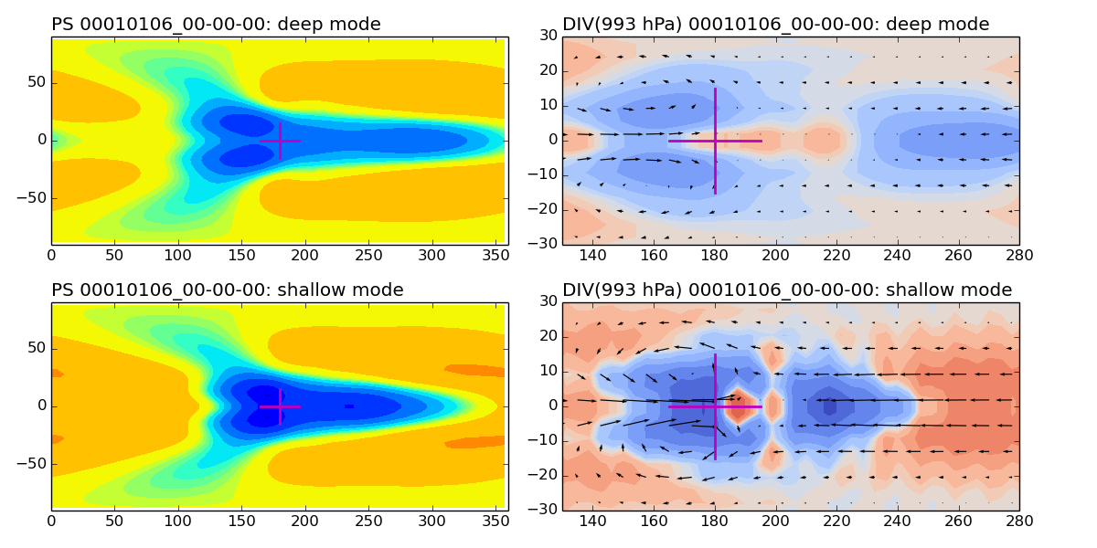
Steady forcing: Day 5

Slide 21
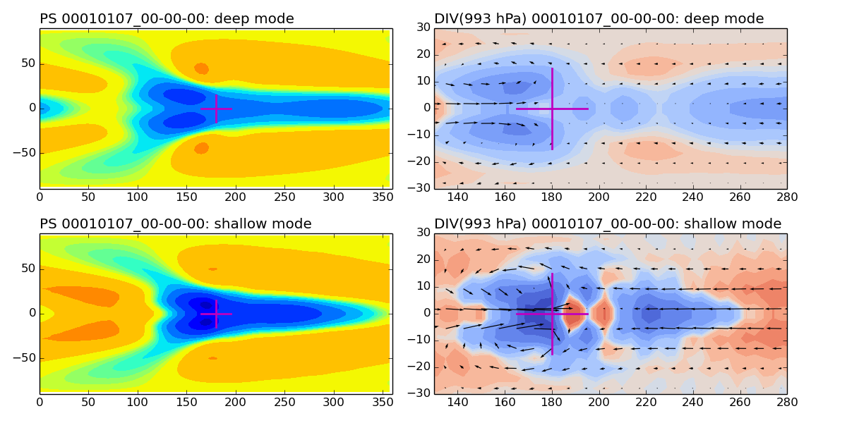
Steady forcing: Day 6

Slide 22
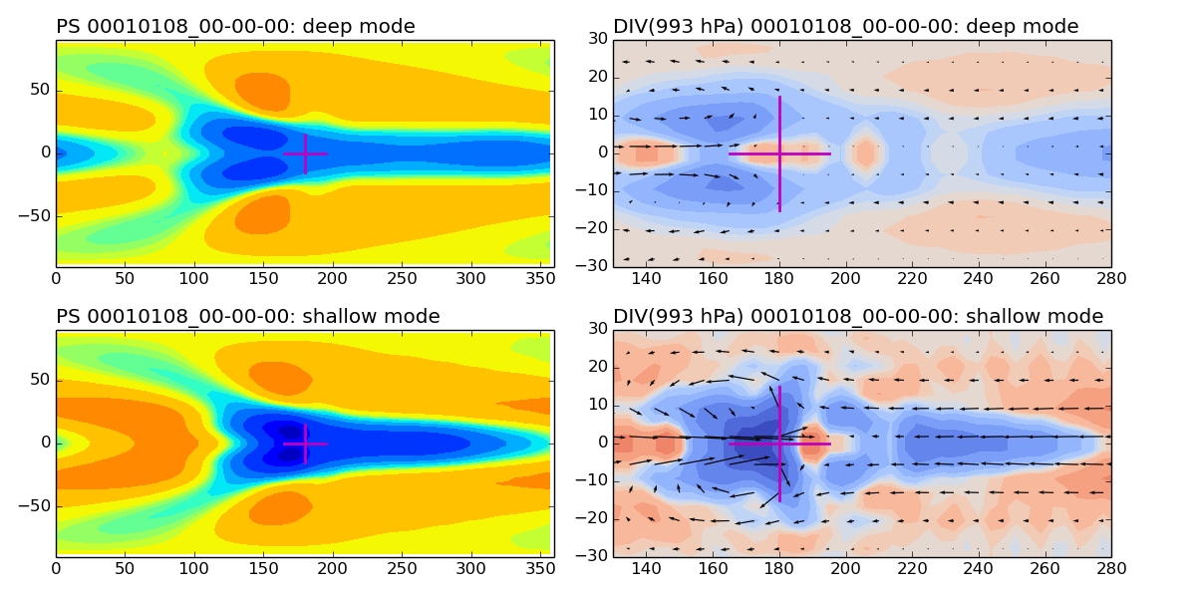
Steady forcing: Day 7

Slide 23
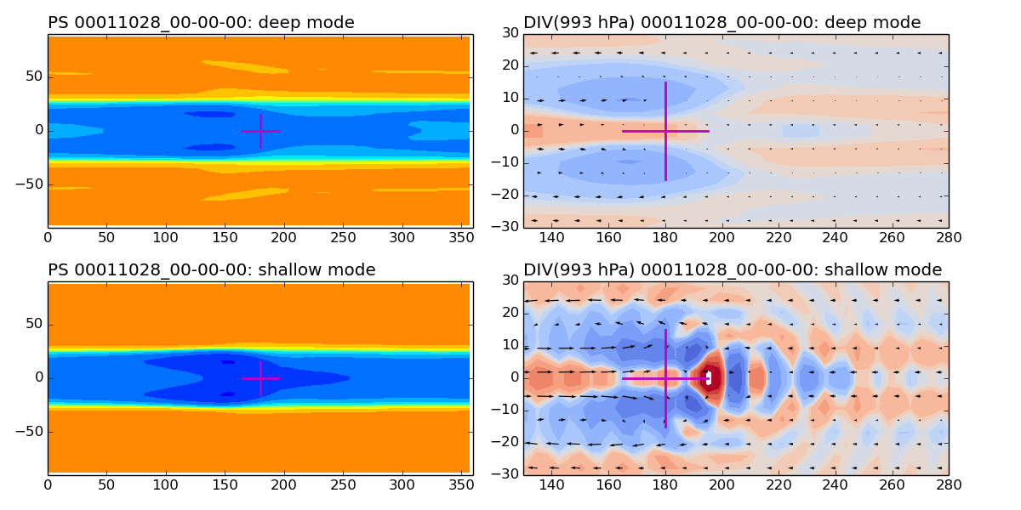
Steady forcing: Day 300

Slide 24
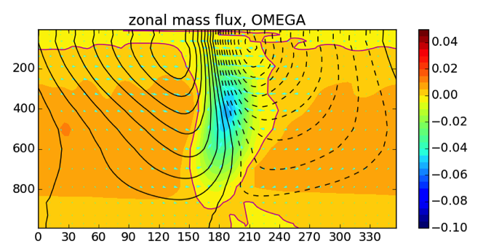
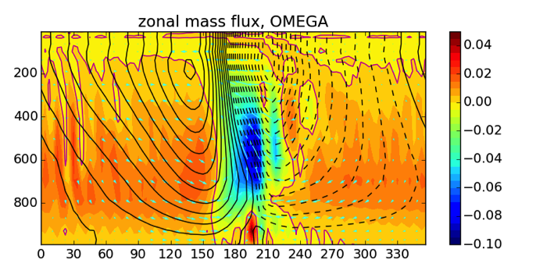
Steady forcing:
200th ~ 300th day
Deep
shallow

Slide 25
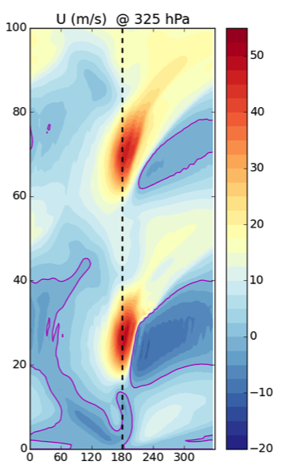
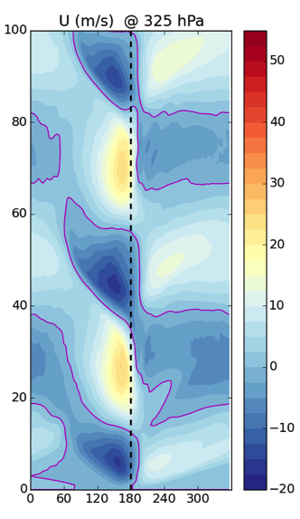
Oscillating forcing
Deep shallow

Slide 26
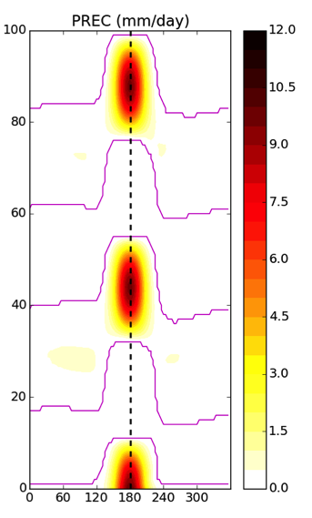

Oscillating forcing
Deep shallow

Slide 27
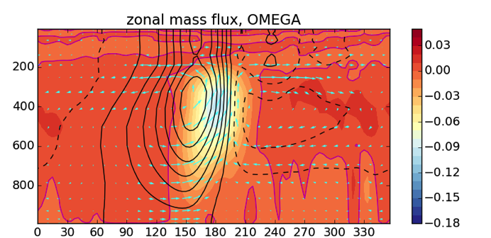
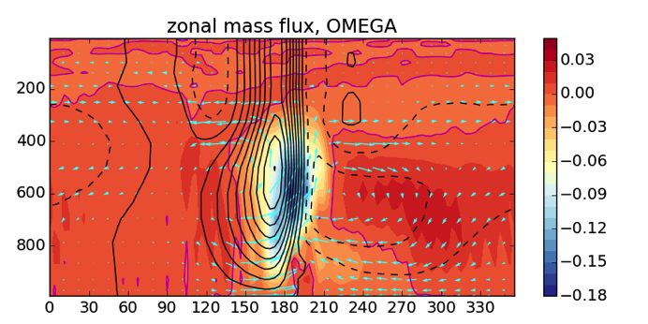
Oscillating forcing:
44th day
Deep
shallow

Slide 28
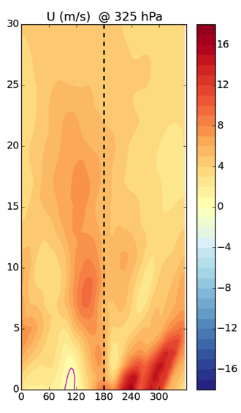
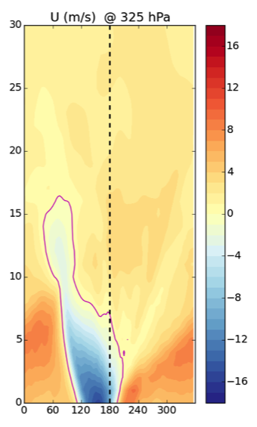
Shut down forcing: decayed waves
Deep shallow
c~40 m/s
p~6 days

Slide 29
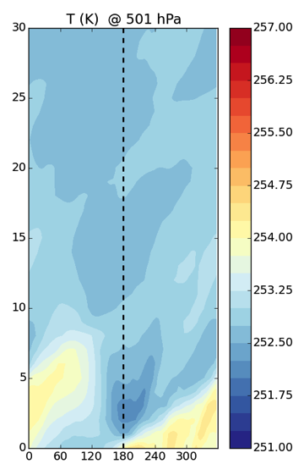
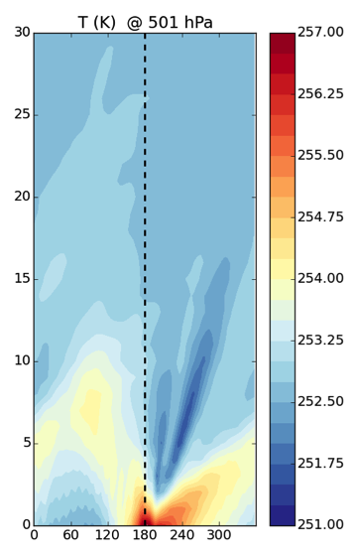
Shut down forcing: decayed waves
Deep shallow

Slide 30
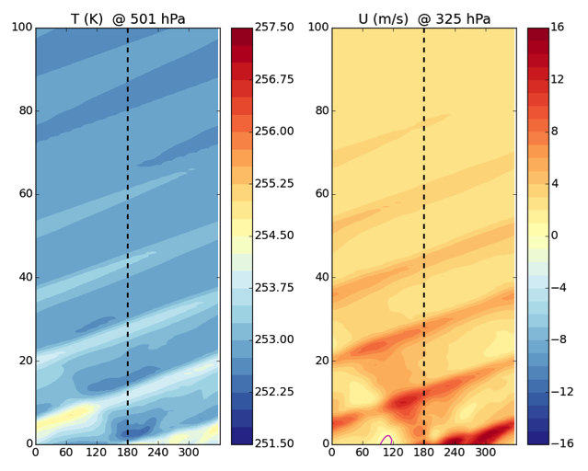
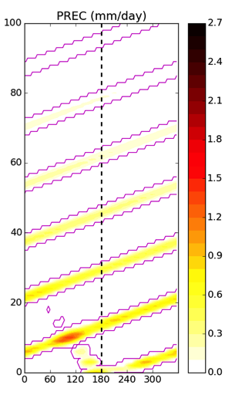
Wave-CISK like physics: PBL convergence triggered heating
Deep case:
c~30 m/s
p~16 days

Slide 31
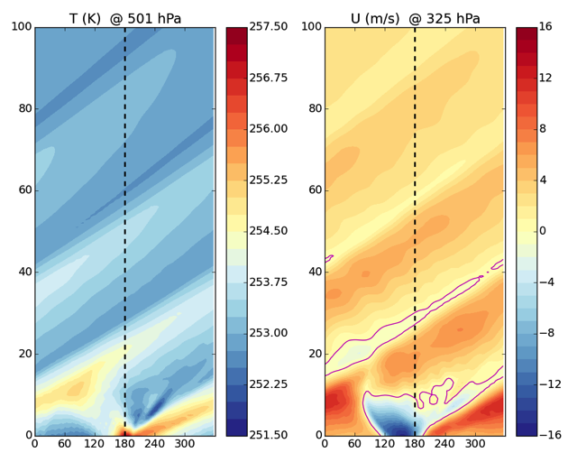
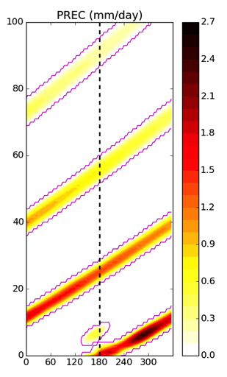
Wave-CISK like physics: PBL convergence triggered heating
Shallow case:
c~14 m/s
p~34 days

Slide 32
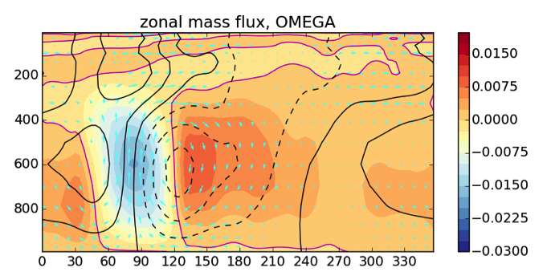
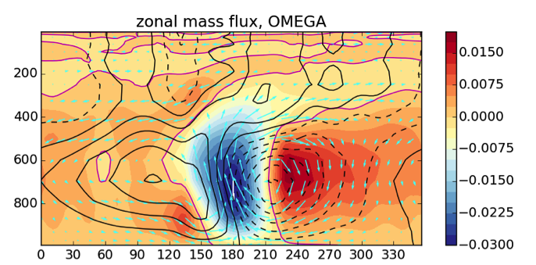
Wave-CISK like physics cases @ 25th day
Deep case
Shallow case

Slide 33
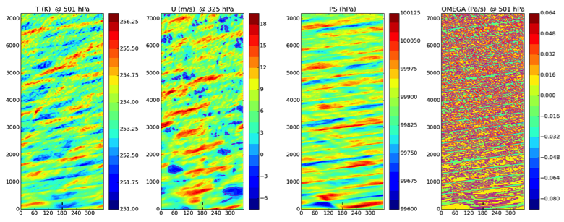
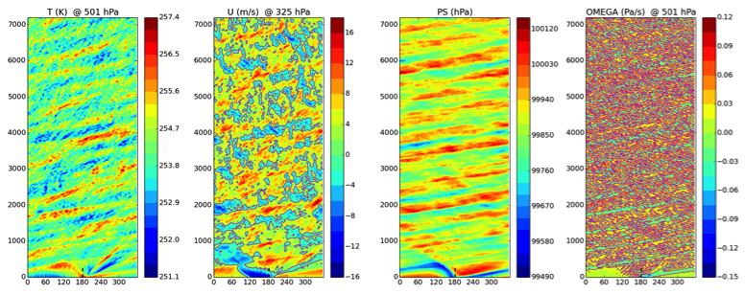
No physics
No RF
No NC
No HD
I.C.: deep case
I.C.: shallow case

Slide 34
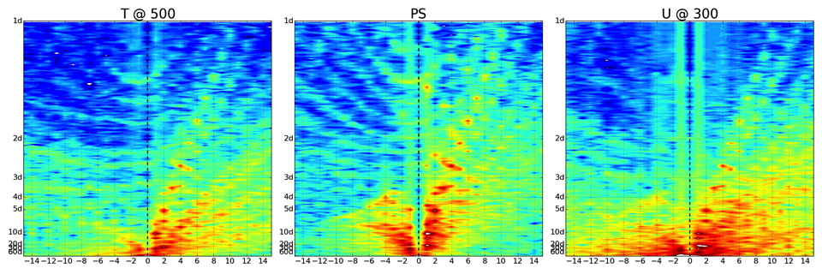
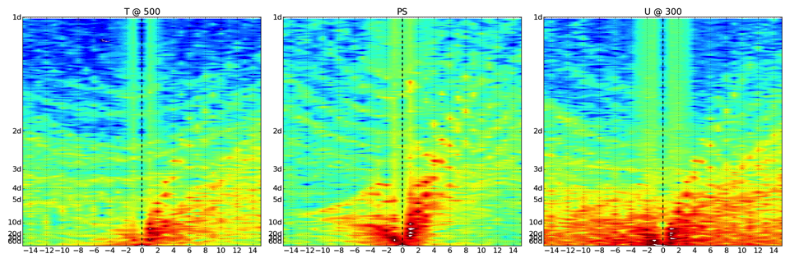
T @ 500hPa PS U @ 300hPa

Slide 35
T @ 500hPa PS U @ 300hPa

Slide 36
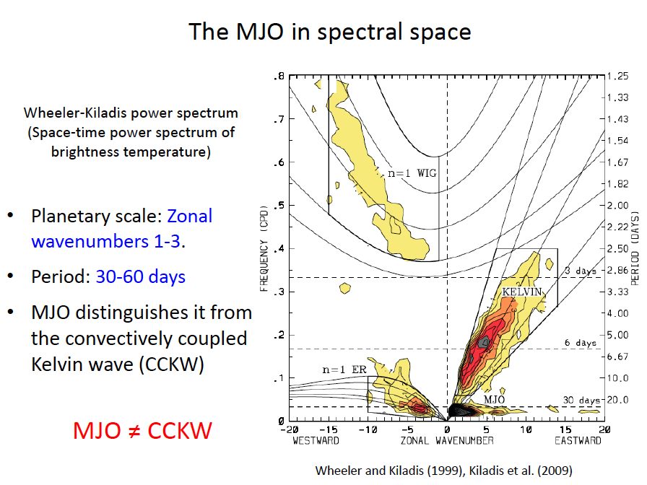
Lecture09 slide
But they do have some overlap

Slide 37
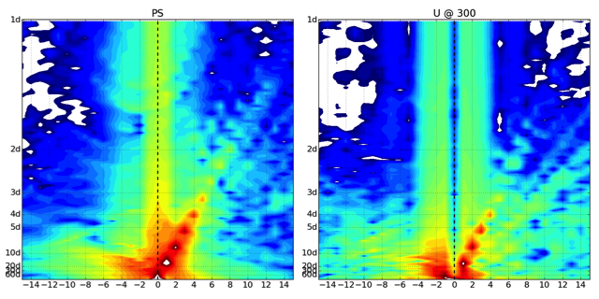
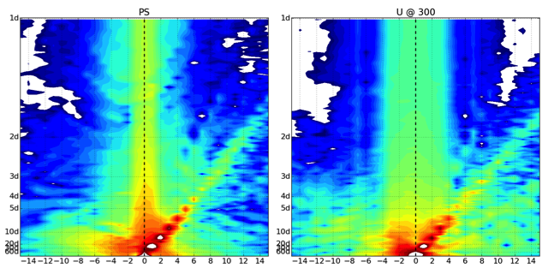
PS U @ 300hPa
Deep wave-CISK physics
Shallow wave-CISK physics

Slide 38
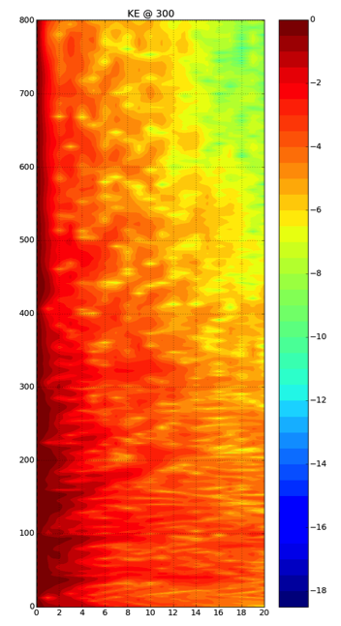
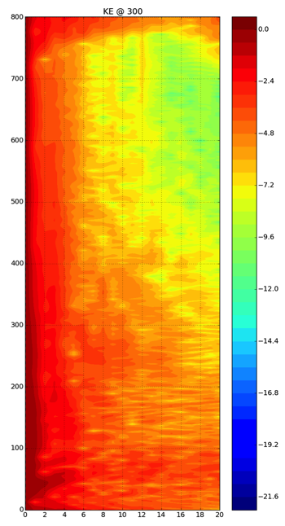
Deep shallow
KE cascade

Slide 39
Summary
Large-scale circulation
Heating with shallow mode generates stronger upward motion, low-level convergence, westward tilting, and Walker circulation;
Wave propagation
Heating with shallow mode results in inactive energy cascade, longer time scale of overturning eddies, and eventually slower eastward wave propagation.

Slide 40
References
Hartmann, D.L., H.H. Hendon, and R.A. Houze, 1984: Some Implications of the Mesoscale Circulations in Tropical Cloud Clusters for Large-Scale Dynamics and Climate. J. Atmos. Sci., 41, 113–121.
Lau, K.M. and L.L. Peng, 1987: Origin of Low-Frequency (Intraseasonal) Oscillations in the Tropical Atmosphere. Part I: Basic Theory. J. Atmos. Sci., 44, 950–972.
Wu, Z., 2003: A Shallow CISK, Deep Equilibrium Mechanism for the Interaction between Large-Scale Convection and Large-Scale Circulations in the Tropics. J. Atmos. Sci., 60, 377–392.
Haertel, P.T., G.N. Kiladis, A. Denno, and T.M. Rickenbach, 2008: Vertical-Mode Decompositions of 2-Day Waves and the Madden–Julian Oscillation. J. Atmos. Sci., 65, 813–833.
Sui, C. and K. Lau, 1989: Origin of Low-Frequency (Intraseasonal) Oscilliations in the Tropical Atmosphere. Part II: Structure and Propagation of Mobile Wave-CISK Modes and Their Modification by Lower Boundary Forcings. J. Atmos. Sci., 46, 37–56.
Kiladis, G. N., M. C. Wheeler, P. T. Haertel, K. H. Straub, and P. E. Roundy (2009), Convectively coupled equatorial waves,Rev. Geophys., 47, RG2003.
G. J., and X. Song (2009), Interaction of deep and shallow convection is key to Madden-Julian Oscillation simulation, Geophys. Res. Lett., 36, L09708.

Slide 41
Appendix A. Diabatic heating:

Slide 42
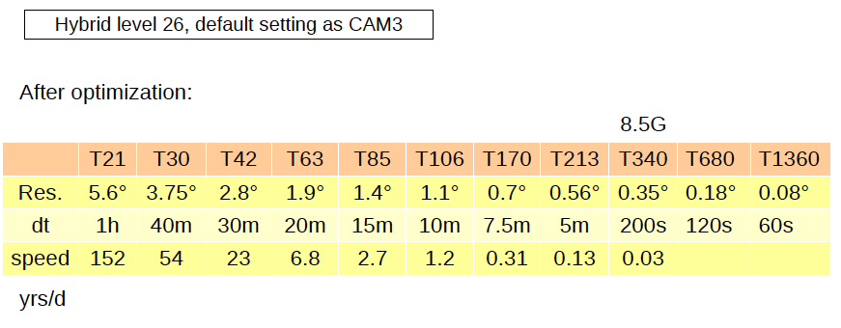
Appendix B. Model performance
Running speed tests on PC : nlev=26

Slide 43
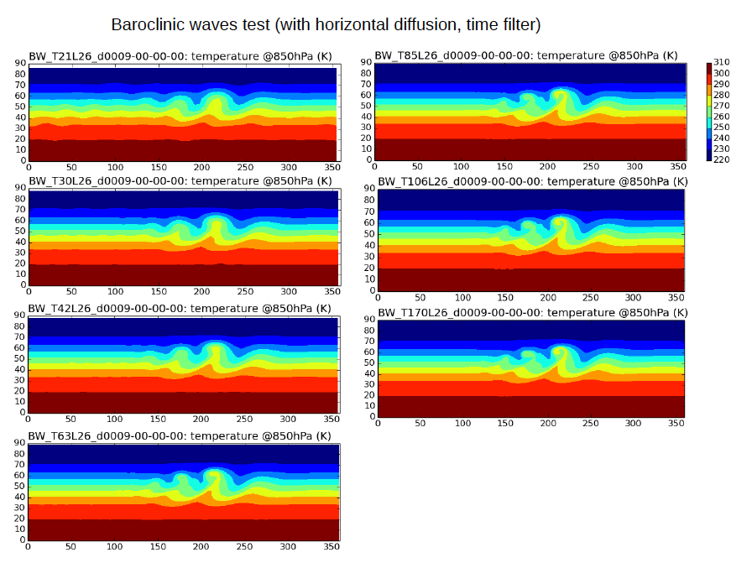

Slide 44
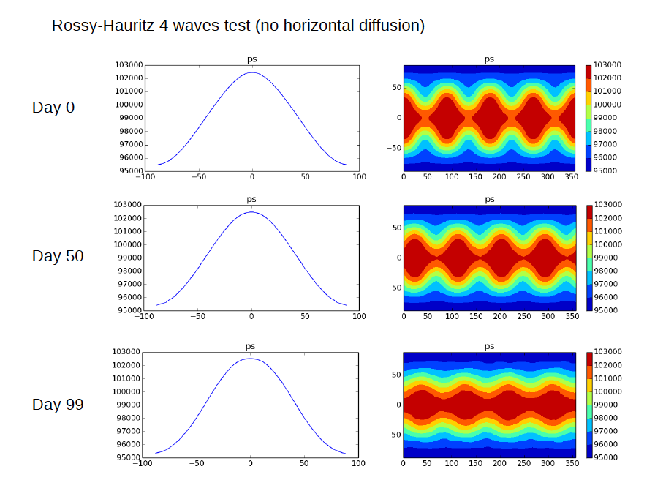

Slide 45
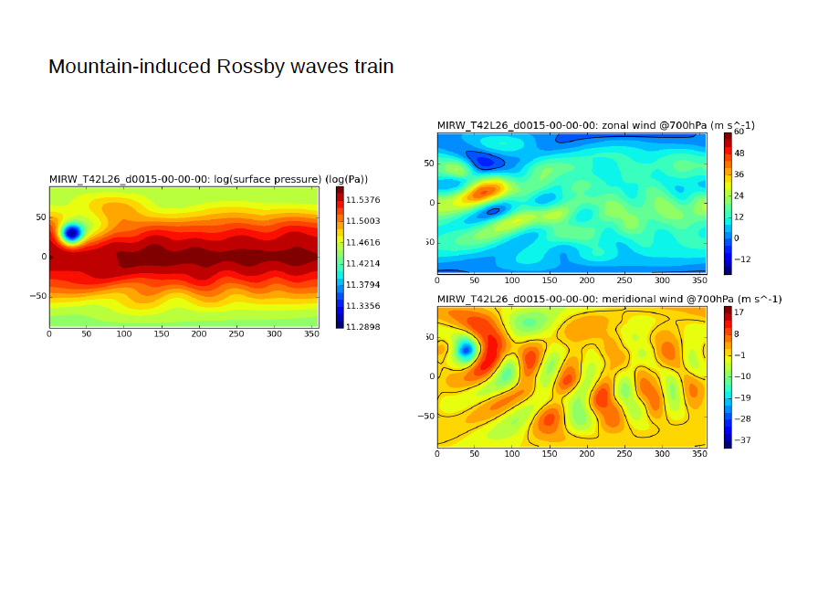

Slide 46
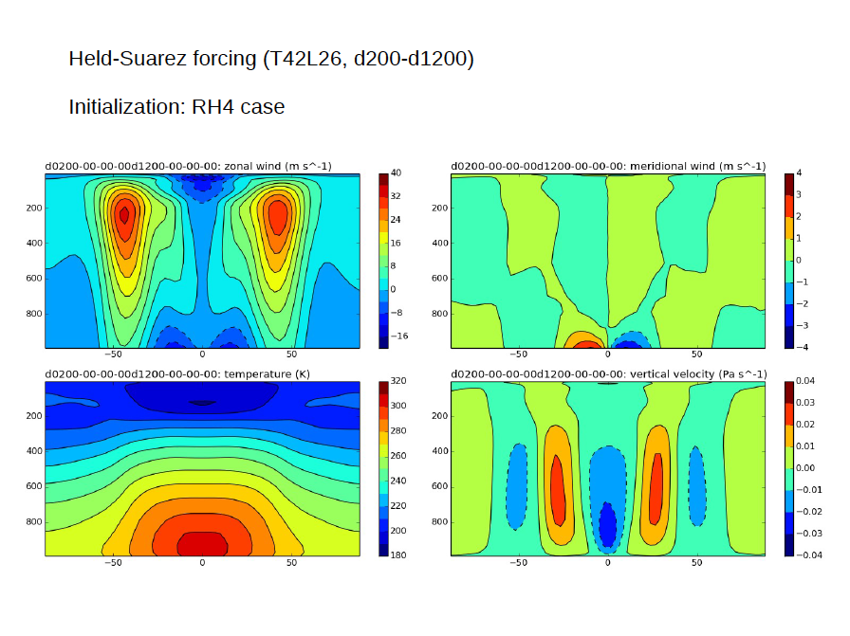

Slide 47
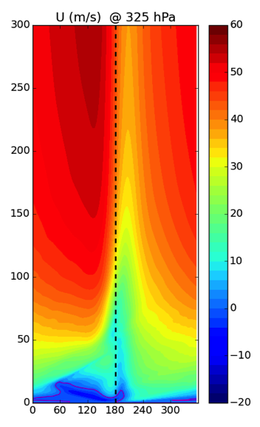
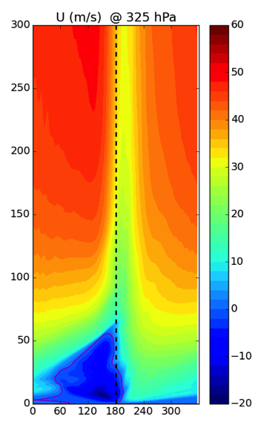
Appendix C. Steady forcing
Deep shallow

Slide 48
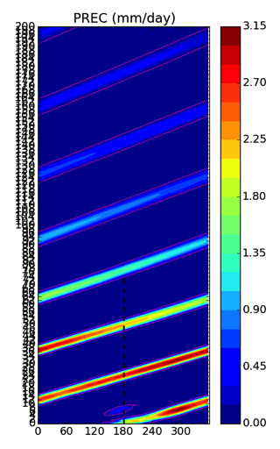
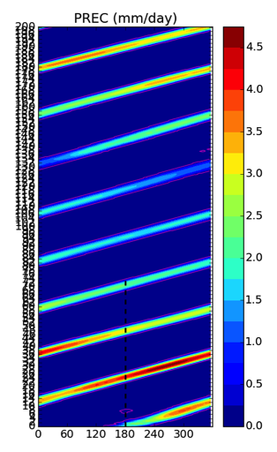
Appendix D. Rayleigh friction effect
RF = 10 day⁻¹
No RF

